Slide 1
Report
Oct-2023 MP Inspection BFX – UA300
Date : 20-Dec-2023
Prepared by: Rachel Ruan

Slide 2
Issue Description
16-Nov, ALT customer complain [BFX-UA300] Oct – 2023 Mass production issue.
Overall inspection result => Conditional Pass
Defect Total:
• Critical
N/A
• Major
Screw inside * 1pcs
• Minor
1. Top cover scratch * 1pcs
2. HDMI cable NG * 2pcs
-No TV screen
-Cable scratch

Slide 3
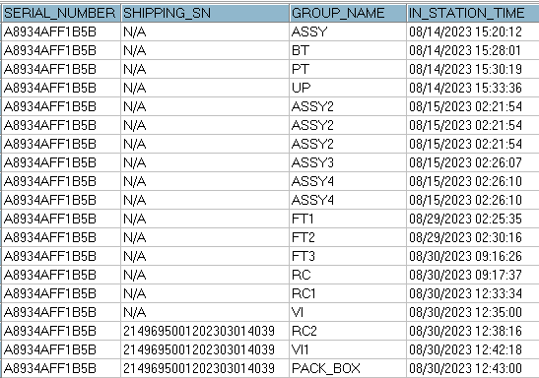
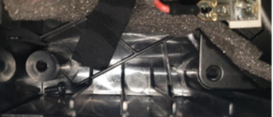
1. Screw is inside the housing * 1pcs
Issue Description | FA | Root Cause & Action | Status
Symptom: screw is inside the housing Type: Major Defect unit Try : 1/316pcs Defect rate : 0.3% SKB SN: 2149695001202303014039 | ALT Check this unit speaker test issue. ALT Customer check visual check : No found abnormal, Open housing see the screw inside. Fiji Check FATP data Product test FATP pass normally. Recheck log test all function test station is normally: | Occur cause: On production line may be OP doing not carefully make screw drop inside housing when they assembly speaker. Escape cause: 1. SOP defined request OP do “up side down “ bot cover before assembly with top cover, but OP didn’t doing follow SOP. 2. Customer request Assembly Shaking test Not allowed abnormal sound i.g : Abnormal sound inside the housing – Screw, cable, etc. But OP no check all product cause this product quite heavy and difficult to shake. Action: Update Quality arlam hang production line Training OP doing follow SOP. Shake 100% product at Visual station. Add OBA test function and inspection cosmetic check and shake product.

Slide 4

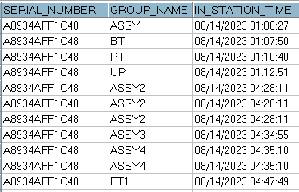

2. Top cover scratch * 1pcs
Issue Description | FA | Root Cause & Action | Status
Symptom: Top cover scratch *1psc Type: Minor Defect unit Try : 1/316pcs Defect rate : 0.3% 2149695001202303014011 | ALT Customer check visual check : Found abnormal, Top housing was scratch. ( without feel ) Fiji Check FATP data Product test FATP pass normally. All FATP is normal process. No any repair or dis-assembly housing recode. 3. Check history assembly this unit had assy on Aug/2023. this time all TOP housing incoming have mylar protected packing. | Root Cause: Incoming material had scratch issue. Because this time Top cover incoming have mylar protected , We no remove this protect throughout online to before the last Visual inspection. 2. On production line may be OP doing not carefully make Top side scratch issue. Action: Incoming material now no mylar protect paste. We can check VI before assembly and inform to vendor if defect scratch by housing material. Online production, doing follow SOP, self check and re-check each station, . With NG production doing follow SFC control process.

Slide 5
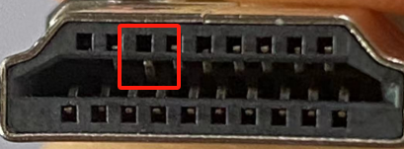
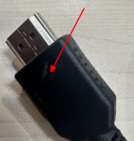
2. HDMI Cable – No TV screen * 2pcs
Issue Description | FA | Status
Symptom: HDMI Cable – No TV screen *1psc Type: Minor, Defect rate : 0.6% Defect unit Try : 2/316pcs ALT customer Visual check : No found abnormal. Function check : NG , HDMI Cable scratch • TV (LG, 49UF6800) : No HDMI screen • TV (Samsung, UN50JU6800F) : No HDMI screen | 1. 04-Dec/2023 Fii sent to FIT vendor 01 pcs NG sample – No HDMI screen. 2. 2023/12/15 Received the defective sample, confirm the appearance of the product, the A-end connector is normal, and the pin of the B-end connector is sunk. 3. Re-tested by Hi-pot test, static test passed and dynamic test failed. After connecting the TV, the static test picture is ok, and the TV picture of swinging 60 degrees shows no picture. 4. Check Solder / appearance/reliability test record / work station no abnormalities found. 5. Check the maintenance records , Confirm the test machine of the maintenance Use OK product for multiple insertion and removal verification, after 10 insertion and removal. The PIN foot has a slight sinking phenomenon and intermittent poor contact breaks will occur in electrical tests.

Slide 6
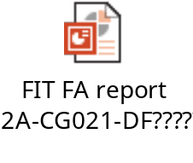
2. HDMI Cable – No TV screen * 2pcs
Root Cause | Action | Status
Occur Cause: ( Material Incoming issue ) 1. When the male and female electrical test connectors are inserted, the butt joints have foreign bodies and are inserted and removed repeatedly during operation .When the PIN is inserted, the top of the PIN is sunk, resulting in poor contact, resulting in customer feedback. 2. After the maintenance OK product test, the connector is not checked again. Escape Cause: ( Fii packing no check function ) 2. HDMI cable is accessory material. Online no any function test. On IQC station - IQC test connecter testing follow AQL: 10.0 ( Function test ). AQL 1.5 ( Visual inspection ). | FIT vendor Action : FIT Sorting Inventory: 2000PCS 100%sorting No defective products : Owner guojuanxie 2023/12/18 Done. 2. On production lines .The line leader and quality assurance shall confirm the status of the test fixture every 4H, and record it in the Test machine spot inspection Record Form. If any abnormality is found, replace it immediately. 3. Optimize the maintenance process, the product can not directly return the packaging station after the repair is OK, need to return to the electrical T3 test station (electrical test → screen test → appearance terminal full inspection) to avoid leakage caused by no secondary inspection. 4. Fii Action: On IQC station , Tighten material incoming inspection - IQC test connecter testing follow AQL: 6.5 ( Function test ). And Visual inspection up to: AQL:0.4. => Apply from the fist lots Dec-2023.

